Slide 1


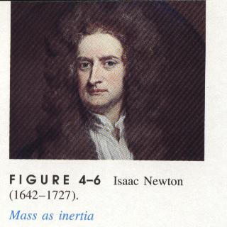
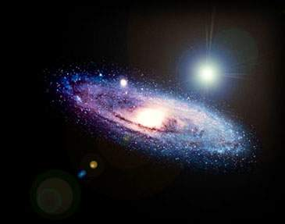
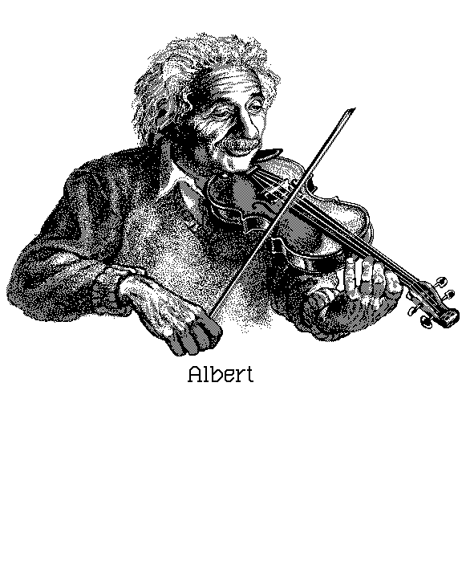
UNIVERSITY PHYSICS 2

Slide 2

Chapter 8
Electromagnetic
Induction
第八章 电磁感应

Slide 3

§ 8-1 Nonelectrostatic Force Source &
Electromotive Force 非静电力 电源 电动势
§ 8-2 Faraday’s Law of Induction
电磁感应定律
§ 8-3 Motional Electromotive Force
动生电动势
§ 8-4 Induced Electric Field
感生电动势 涡旋电场
§ 8-5 Self-induction & Mutual-induction
自感和互感
§ 8-6 Energy of the Magnetic Field 磁场的能量

Slide 4


教学要求
1. 掌握用法拉第定律计算感生电动势及判断方向；
2. 理解感生电动势和动生电动势的产生原因；
3. 理解涡旋电场与静电场的区别；
4. 了解自感与互感，能计算简单回路的L，M；
5. 能计算简单磁场的磁能W_{m}。

Slide 5
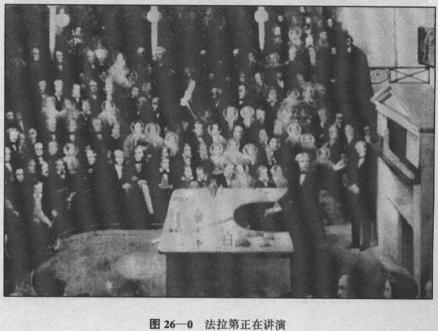
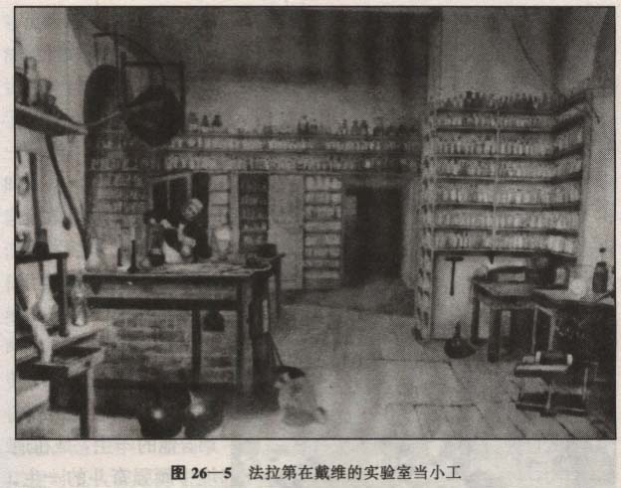
Introduction
Michael Faraday: 1791-1867,英国物理学家、化学家，1831发现电磁感应定律，1834年发现电解定律，提出电场和磁场概念，还提出：电介质、电解质、离子、阴离子、阳离子、力线、阳极、阴极、电极、抗磁、顺磁…….

Slide 6
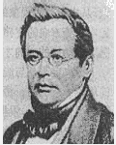
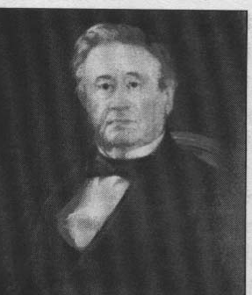
Lenz:1804-1865，俄籍德国物理学家，1833年总结出 lenz law，它表明电磁现象也同样遵守能量转换和守恒定律。
Joseph Henry:1797-1878, 美国物理学家，先于Faraday发现电磁感应定律，只是没有及时发表，发现自感现象。

Slide 7

§8-1 Nonelectrostatic Force Source &
Electromotive Force
非静电力 电源 电动
1. Nonelectrostatic Force非静电力
A
B
图中，A，B 为电容器极板，
开始时， ，在电场力
作用下，正电荷从A板经导线
到了B板与负电荷中和，极板
上的电荷减少，电势差减小，
很快达 V=0，瞬间电流停止。
结论：单靠静电力不能维持
稳恒电流。
R

Slide 8
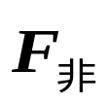

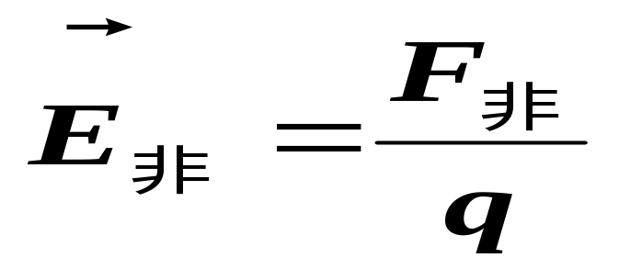
为了维持电流，必须使到B板的正电荷经另一路径回到A极，但静电力是阻止正电荷从低电势运动到高电势。
A
B
A
B
R
R
Nonelectrostatic Field
电源的作用：提供非静电力 把正电荷从低电势的B极沿电源内部移到高电势的A极，从而维持两极电势差。

Slide 9
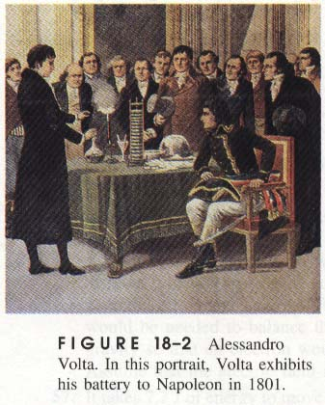
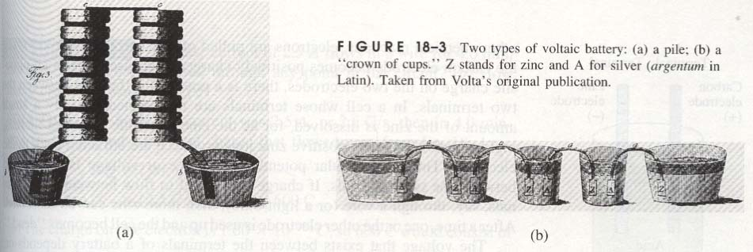

Slide 10
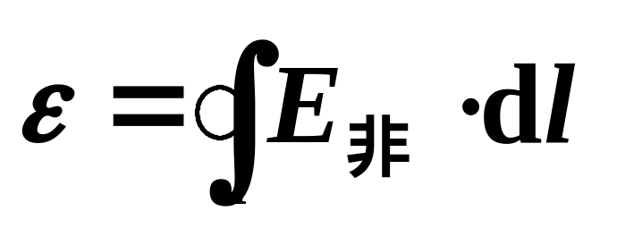
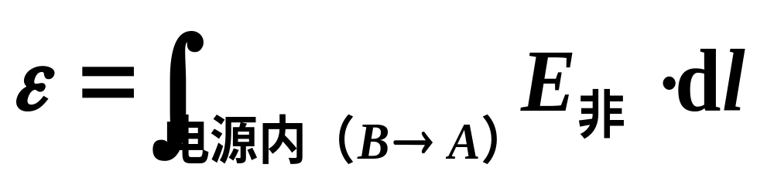
2. Electromotive Force 电动势
把单位正电荷经电源内部绕行闭合回路一周时非静
电力所作的功定义为电源的电动势
A
B
R
电动势为标量，把电源内部电势升高的方向规定为电动势的方向（即从负极经电源内部指向正极的方向）。

Slide 11


Slide 12
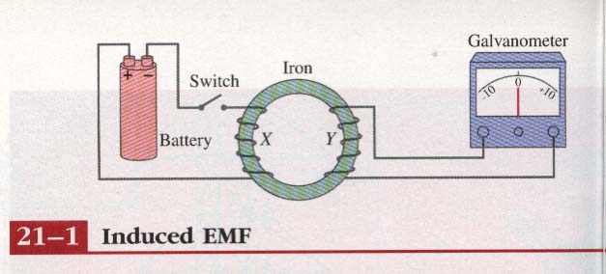
§8-2 Faraday’s Law of Induction
电磁感应定律
1. Induction phenomena 电磁感应现象
In 1831.8.29 Faraday used the following apparatus(仪器）to find the electromagnetic induction:

Slide 13
Demonstration experiments(演示实验)of the electromagnetic induction.
Coils线圈
magnet
G
G
× × × × × × ×
× × × × × × ×
× × × × × × ×
× × × × × × ×
a
A conductor is moving in a magnetic field.
G
b

Slide 14
A current appears only if there is relative motion between the coil and the magnet( one must move relative to the other); the current disappears when the relative motion between them ceases(终，停止）。
Relative motion
G
The induced emf(electromotive force电动势） and induced current in these experiments are apparently caused when something changes--but what is that something?. Faraday knew!!

Slide 15
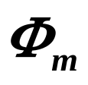


2.Faraday’s Law of Induction法拉第电磁感应定律
Faraday’s law of induction, stated in terms of above experiments, is this:
An emf is induced in the loop(coils) when the number of magnetic field lines (magnetic flux )that pass through the loop is changing.
changing

Slide 16
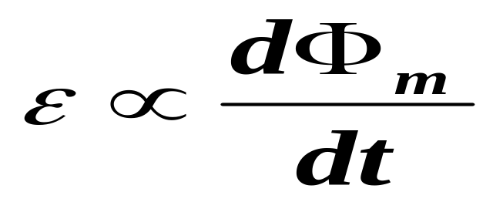
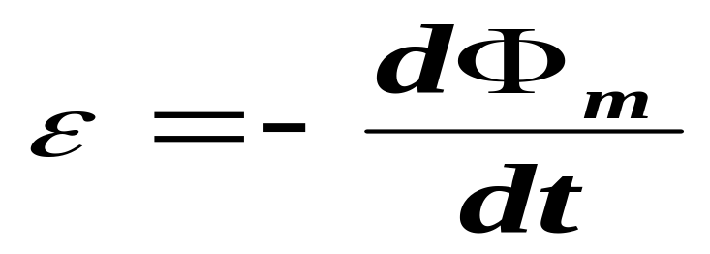
With the notion of magnetic flux, we can state Faraday’s law in a more quantitative(定量的） and useful way:
As you will see in the following, the induced emf tends to oppose the flux change,so Faraday’s law is formally written as
(SI)

Slide 17


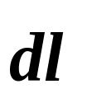
The minus sign(负号） indicates that opposition:
increasing
decreasing

Slide 18
Lenz’s Law:
An induced current has a direction such that the magnetic field due to the current opposes the change in the magnetic flux that induces the current.The direction of an induced emf is that of the induced current.
decreasing

Slide 19
楞次定律:
磁通量的变化
感应电流
闭合回路中产生的感应电流具有确定的方向，总是使感应电流所产生的通过回路面积的磁通量，去补偿或反抗引起感应电流的磁通量的变化。
试用楞次定律判断上例中感应电动势和
感应电流的方向。

Slide 20
The general means by which we can change the magnetic flux through a coil or loop:
1)Change the magnitude of ;
2)Change the area of the coil or loop(for example, by expanding the coil or sliding it in or out of the field);
3)Change the angle between the direction of and the area of the coil.

Slide 21





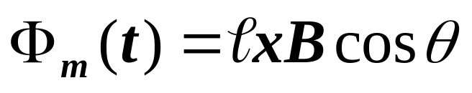

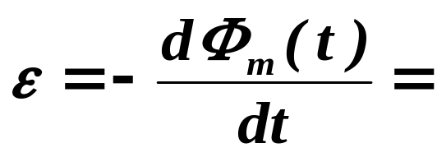
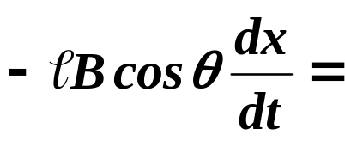
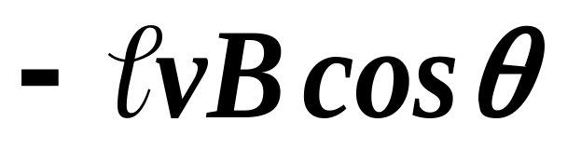


Example 8-1:如图所示，棒ab长为，沿两平行的轨道以速度v在均匀的磁场中运动，求回路中的感应电动势。
解：（1）选回路方向abcda;
(2)设t时刻 da=x,计算磁通量：
（3）应用 Faraday’s law,有：
（4）感应电动势的大小为 ，方向 。

Slide 22

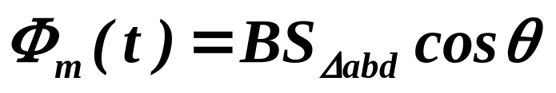
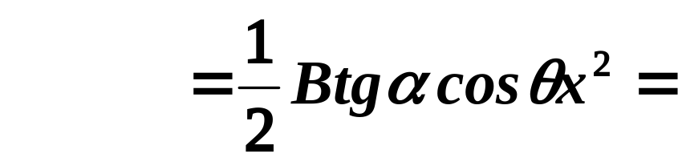
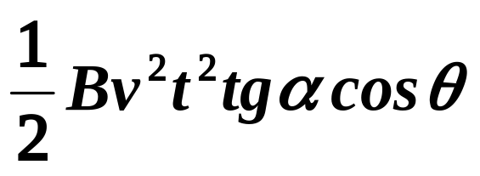
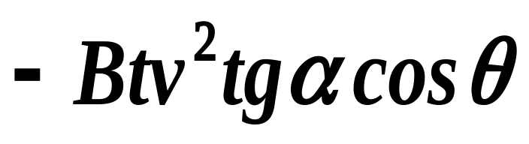
Example 8-2:如图所示，棒ab长为，沿两角形的轨道以速度v在均匀的磁场中运动，求回路中的感应电动势。
解：（1）选回路方向abda;
(2)设t时刻 da=x,计算磁通量：
（3）应用 Faraday’s law,有：
（4）方向：

Slide 23







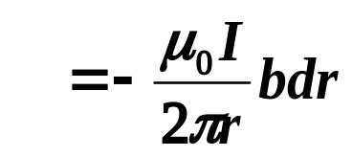


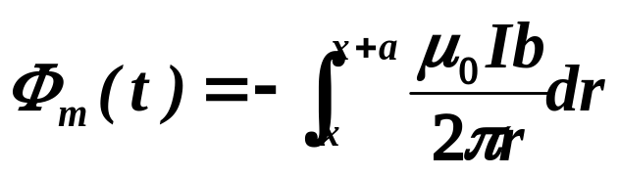

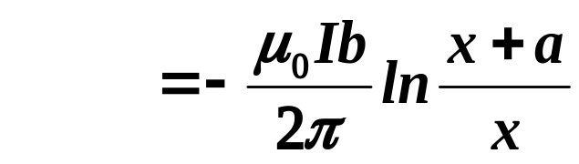
Example 8-3:如图所示，长直导线中通有 ，旁有一矩形线框静止不动，两长边与直导线平行，求回路中的感应电动势。
解：（1）选回路方向ABCDA;
(2)设t时刻 的方向垂直于板面向里,计算磁通量：

Slide 24
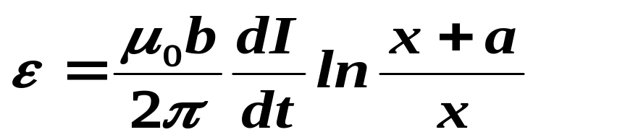
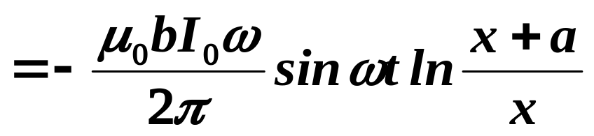
（3）应用 Faraday’s law,有：
（4）方向：随时间而变化。

Slide 25
基本步骤：
选定回路方向；
计算任意时刻的磁通量；
应用Faraday’s law求感应电动势及其它；
讨论感应电动势（或电流）的方向。

Slide 27

§8-3 Motional Electromotive Force 动生电动势
1.Introduction
Means to lead to the change of magnetic flux:
By the motion of conductor( steady);
is varying and conductor is at rest;
is varying and conductor is moving.
Explain: why and importance.

Slide 28

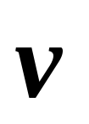
In the case of the motion of conductor:
a
Non-electrostatic Force
G
What?
b
Lorentz force
Motional Electromotive Force
动生电动势

Slide 29

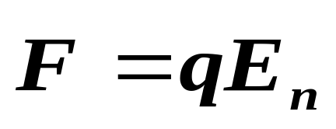
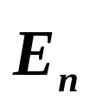
In the case of B varying and conductor at rest:
Non-electrostatic Force
What?
G
涡旋电场力
In 1861,Maxwell: induced electric field .
感生电动势

Slide 30
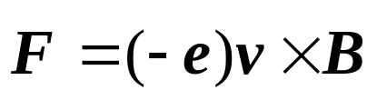
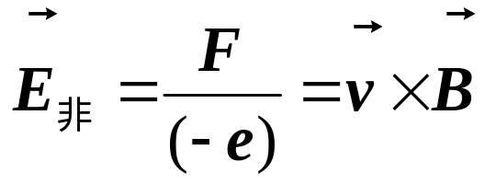
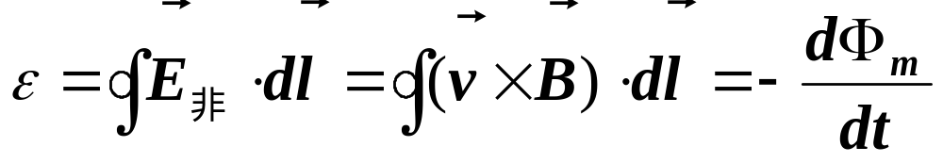
2. Motional Electromotive Force 动生电动势
a
导体运动 电子运动
G
Lorentz force:
b
非静电力：
Induced emf:

Slide 31
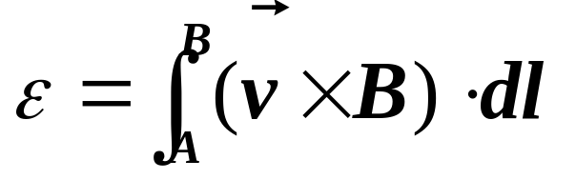
Note:
(1)For the conductor AB, the above formula can been rewritten as:
B
A
(2)If AB does not form a loop, there is not any induced current:
Copper铜
Wood(木)
broken
No
No

Slide 32
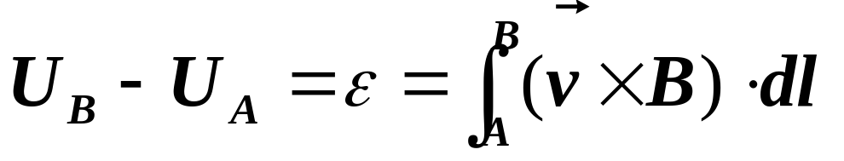
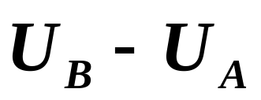
(3)对导体AB，电荷堆积在AB两端点，产生静电场，平衡后，AB相当于电源，正负两极的电势差为：
B
A
指向
ε：低电势
高电势，非静电力做功大小的量度；
： 电场力做功大小的量度；

Slide 33
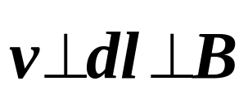
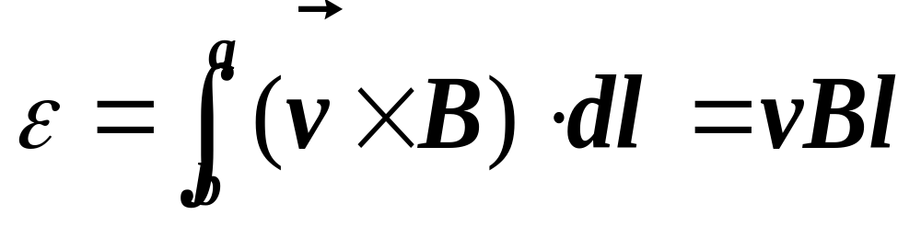


（4）If AB is straight (直的)and that is uniform as shown in Figure. We have:
a
G
b
The potential is higher than .

Slide 34



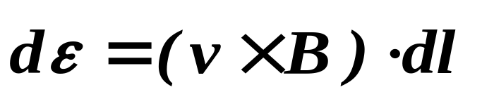
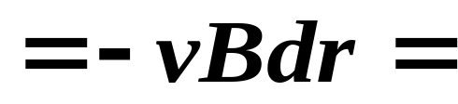
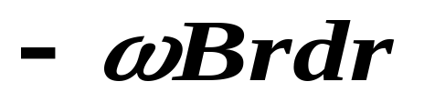
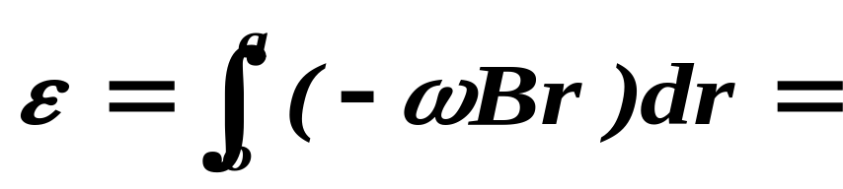
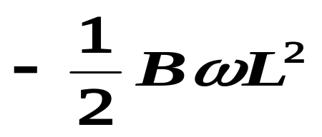

Example 8-5：Example 12-3(English) or
P321 8-2 例1(Chinese).
解：（1）选：o→a；
（2）oa旋转，其上各点的速度不同，取dr，有：
（3）oa上的动生电动势为：

Slide 35


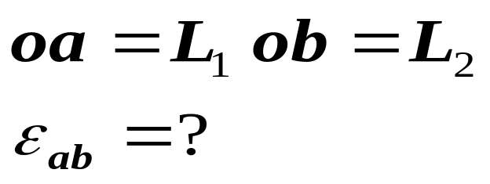
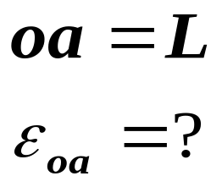
（4） 的方向： ；
o端的电势高，a端的电势高低。
（5）一般情况：

Slide 36



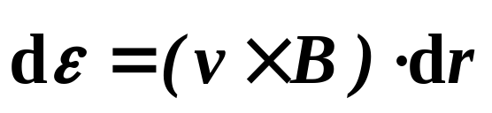



Example 8-6：如图，长直导线中通有电流I，旁有一直导体AB以速度 运动，求AB中的动生电动势，A和B哪点的电势高？
解：(1)磁场非均匀，不随时间变；导体运动，速度不变。
(2)选： ；取dr,有：
(3)AB上的动生电动势：

Slide 37



(4)动生电动势的大小为：
方向： ，A点电势高。
(5)一般情况：

Slide 39

§8-4 Induced Electromotive Force 感生电动势 Induced Electric Fields 有旋电场
1.Introduction
Non-electro-
static ?
Induced current
G
G
K
Varying magnetic field

Slide 40



试验研究表明:导体不动,磁场变化,回路中的感应电动势与组成回路的材料性质无关,只与磁场的变化相关.
1861年,Maxwell认为即使不存在导体回路,变化的磁场会在其周围激发出一种场:A changing magnetic field produces an electric field.他把这种场称为:
变,回路不动
感应电场或涡旋电场
这是Maxwell为统一电磁场理论作出的第一个重大假设!!

Slide 41

涡旋电场的特点:
与静电场的共同点就是对电荷有相互作用:
涡旋电场不是由电荷激发的,而是由变化的磁场所激发;
涡旋电场的电力线是闭合的,不是保守场:

Slide 42

2.感生电动势:
回路上有
涡旋电场
涡旋电场对电荷的作用力,就是产生感生电动势的非静电力.
所以:

Slide 43

Note:
(1)对于导体运动磁场也变化的情况,电荷将同时受到Lorentz force and涡旋电场的作用,感应电动势由Faraday’s law求出:
a
B变化
G
b

Slide 44
(2)回路不动,磁场变化,如果回路由导体组成,存在感应电流,除与磁场的变化有关外,还决定于回路的电阻;如果不是导体回路,感生电动势存在,没有感应电流.
Copper铜
emf
Wood(木)
No current

Slide 45



3.An important example:
:均匀磁场B被局限在半径为R的空间,磁场对时间的变化率为 ,求柱体内外的涡旋电场场强.
解:(1)对称性分析:
磁场对称→涡旋电场对称分布
(2)如图取回路: 大小相等,方向沿切线方向;
O

Slide 46






(3)According to Faraday’s law:
O
Therefore:
(4)When , and we have
Direction: opposite to .

Slide 47







(5)When , and we have
Direction: opposite to .
(6) is shown in Figure.
(7)directions:
Anticlockwise(逆时针)
clockwise(顺时针)

Slide 48


Summary:
In general, the following three methods can be accepted to find the induced emf:
(1)Faraday’s law
(2)For the case in which magnetic field is not varying:
(3)When the conductor is at rest:

Slide 49



4.Vortex Current 涡电流
(1) 涡电流的产生
前面讨论了变化的磁场要在回路中产生感应电流。对于大块的金属导体处在变化的磁场时，导体内也会产生感应电流，这种电流在金属导体内形成闭合回路，称为涡电流。
～
～
(2) 涡电流的热效应
根据电流的热效应，可利用涡电流产生热量，如工业中用的坩埚及电磁炉等;
但变压器等设备则要尽量降低涡电流产生的损耗。
~

Slide 51



§8-5 Self-induction & Mutual-induction 自感和互感
1. Self-induction 自感
It was Joseph Henry who first discovered the self-induction:
which is called the self-induction.

Slide 52

vary
Induced emf
I
Magnetic field
I Vary

Slide 53





As shown in Figure, since magnetic field B is proportional to the current I(t), the magnetic flux is also proportional to the current I. That is:
where L is called the self-inductance(自感系数或自感).

Slide 54



From Faraday’s law,we have:
If L is constant, it follows that:
Explain L: physical meaning. Its unit is Henry denoted to H(SI).

Slide 55




Note:
(1) If the current is increasing, the direction of the induced field is opposite to that of the current;

Slide 56
(2) If the current is decreasing, the direction of the induced field is in the same direction as the current.
Inertia of body
L of inductance

Slide 57


L 取决于:
回路的大小形状及其周围的介质(磁导率).
2.3米

Slide 58


(1) L is determined usually by the experimental measurements;
(2)For particular circuits(电路,回路),L can be obtained by the theoretical method:
设回路电流I,计算磁场B,求出磁通量,得到L.

Slide 59











Example 8-10:(example 9.8 in text)
解:(1)设有电流I,则
(2)计算通过一匝和N匝的磁通量:
(3)自感系数:
V是体积,a为半径(如果横截面为圆形).

Slide 60





2. Mutual(相互的;彼此的)-induction 互感
As shown in Figure, the variation in flux of coil 2 is brought about by a varying current in circuit 1 and then the induced emf is produced, which is called mutual induction.

Slide 61


邻近回路电流变化引起感应电动势的现象，产生的感应电动势称为互感电动势。

Slide 62




We have:
and

Slide 63


It can be proved experimentally that
which is called mutual inductance.

Slide 64


If M is constant, we can obtain from Faraday’s law:

Slide 65





Note:
(1)M越大,两个线圈的‘感应’越大;
(2) ,体现作用与反作用的关系;

Slide 66





(3)M与两线圈的几何形状、相对位置，周围的磁介质有关；

Slide 67

（4）M：一般实验测量；
特殊情况，可理论计算：设某线圈中有电流I，产生磁场；计算在另一线圈中的磁通量；根据公式：
求出互感系数。

Slide 68




Example 8-11：如图，求长直导线与导线框之间的互感系数。
解：（1）设直导线中有电流I₁；
（2）I₁产生磁场：
（3）导线框中的磁通量：
（4）互感系数：

Slide 70


§8-6 Energy stored in a magnetic field 磁场的能量

Slide 71


1.The R-L circuit
Why?
As shown in Figure, the circuit is consist of a source of emf ε, a resistor R(电阻） and an inductor L。
Explain the experimental results:
(1) Switch on: the bulb no immediately shine;
(2) Switch off:no immediately die out; there is a strong flash of lightning before the light die out.

Slide 72

Problem: Where does the energy of the light come from after switch off ?
Magnetic
field
energy
Answer: the energy of the light is transformed from the energy of the magnetic field stored in the solenoid ( inductor L).
energy
The law of conservation of energy: 自感为L的线圈载流为I 时所储存的磁能.

Slide 73






Energy stored in an inductor 自感线圈中储存的磁能
At time t:
That is
Multiplied(乘） by Idt(=dq),we have:

Slide 74




Assuming that at t=0 I=0 and the current reaches I₀ at t=t₀ ,we can obtain
电源供给的总能量；
R上消耗的能量，即焦耳热；
反抗自感电动势电源所作的功，也可理解为电感中储存的能量；显然，L越大，储存的能量越多。

Slide 75

2. Energy stored in magnetic field 磁场的能量
The energy stored in an inductor
energy
is considered as the energy stored in the magnetic field set up in the inductor by the current I₀ .

Slide 76



energy
Using
and
we have
Volume V

Slide 77

The density of magnetic energy( that is the energy stored per unit volume of the field) 磁场的能量（体）密度
which holds（成立） for all magnetic fields even though we derived it by considering the special case of a solenoid.

Slide 78

The total energy stored in the magnetic field is given by

Slide 79



Example 8-12:如图，同轴电缆载有电流I，求单位长度内储存的磁能。
解:（1）磁场：
R₁
R₂
I
r
l
I
dr
（2）磁场的能量密度：

Slide 80




（3）取高为单位长，宽为dr的薄的柱体壳：
R₁
R₂
I
r
l
I
dr

